Slide 1
Electric Vehicle Charging Load Forecasting with an integrated
DeepBoost approach

Slide 2
Table of Contents
1. Introduction
2. Motivation and Contributions
3. The Problem: GHG Emissions & EVs
4. Impact of EVs on Existing Grids
5. DeepBoost Approach Overview
6. Component Models: CatBoost, XgBoost, LSTM, LR
7. Performance Comparison
8. Results and Analysis
9. Dataset and Methodology
10. Conclusion

Slide 3
Introduction: The Problem
1. The transportation sector is a major contributor to greenhouse gas emissions, particularly in urban environments, which raises serious concerns about environmental sustainability and public health.
2.Widespread adoption of Electric Vehicles (EVs) presents a promising solution to mitigate these emissions and promote a more sustainable transportation ecosystem for a greener future.
3.EV introduction brings substantial additional load to the existing power grid, potentially leading to operational challenges and requiring careful management to ensure stability.
4.Accurate forecasting of EV charging load is crucial for effective grid management, resource allocation, and strategic planning to handle the increasing demand from electric vehicles.

Slide 4
GHG Emissions & EVs
1.Greenhouse Gas (GHG) emissions are the primary driver of climate change, posing a significant threat to global ecosystems and human well-being, demanding immediate and impactful action.
2.The transportation sector significantly contributes to these emissions, especially in urban areas, highlighting the urgent need for cleaner and more sustainable transportation alternatives.
3.Widespread adoption of Electric Vehicles (EVs) offers a viable pathway to substantially reduce emissions, promoting a transition towards environmentally friendly transportation systems.
4.EVs can significantly contribute to mitigating climate change and fostering sustainability by decreasing reliance on fossil fuels and reducing the carbon footprint of transportation.

Slide 5
Impact on Existing Grids
1.The increased adoption of Electric Vehicles (EVs) introduces additional load on the existing power grid, potentially straining its capacity and impacting its stability and reliability seriously.
2.Unmanaged EV charging can lead to peak demand issues, causing overloads, voltage drops, and potential damage to grid infrastructure, requiring strategic planning and mitigation.
3.Effective forecasting of EV charging load is essential for proactive grid management, allowing utilities to optimize resource allocation and ensure a stable power supply for all consumers.
4.Advanced forecasting techniques can enable smart charging strategies, which balance EV charging with grid capacity, minimizing negative impacts and maximizing efficiency.

Slide 6
Motivation and Contributions
1.The primary motivation is addressing climate change by reducing GHG emissions through EV adoption, recognizing the urgent need for sustainable transportation solutions globally.
2.The study identifies and aims to solve the problem of increased load on power grids due to EV charging, seeking to prevent adverse effects on grid operation and stability effectively.
3.Development of a novel DeepBoost approach, integrating CatBoost, XgBoost, LSTM, and LR models, to improve the accuracy of day-ahead EV charging station load forecasting.
4.Comprehensive performance comparison of DeepBoost against conventional and hybrid methodologies, showcasing its potential as a superior forecasting technique for practical applications.

Slide 7

Literature review & limitations

Slide 8
Proposed Model: “DeepBoost”
The paper proposes DeepBoost to address several gaps identified in the literature:
  Enhanced Accuracy & Robustness: By integrating diverse models (LSTM for temporal dependencies and GBDTs for complex non-linear patterns), DeepBoost achieves superior forecasting performance, outperforming individual and other hybrid models.
  Overcoming Limitations of Individual Models: Traditional models like ARIMA are limited in handling non-linear and complex patterns. DeepBoost combines the strengths of deep learning and ensemble methods to overcome these limitations.
  Addressing Generalizability: The layered architecture improves the model's ability to perform consistently across different datasets, enhancing its practical applicability.
  Reducing Model Shortcomings: The stacking approach mitigates the overfitting and interpretability issues of complex models by leveraging meta-learning (LR) and parallel training.
  Facilitating Real-world Application: Despite computational challenges, the approach aims at providing more accurate day-ahead load forecasts, facilitating energy scheduling and grid stability, ultimately contributing to sustainable EV infrastructure development.
In summary, DeepBoost is designed as a comprehensive, hybrid approach to improve the accuracy, robustness, and scalability of EV charging station load forecasting compared to previous models.

Slide 9
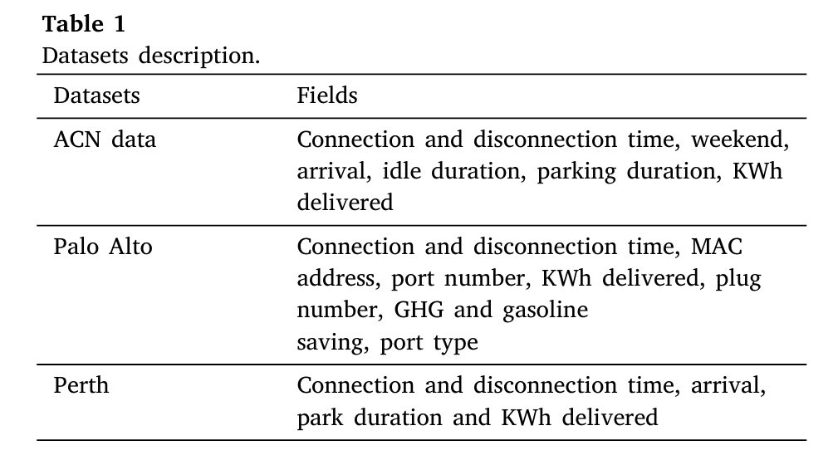
Dataset and Methodology
The study utilizes a comprehensive dataset of EV charging station load data, including historical charging patterns, weather conditions, and other relevant factors affecting charging demand trends.
Data availability The datasets available at the github repository: https://github.com/Ubaid014/DeepBoost-for-EVs-charging-station-load forecasting.

Slide 10
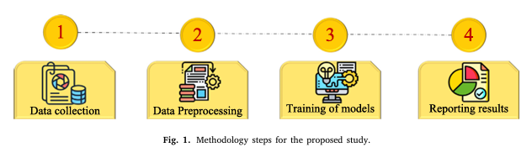
Methodology-Steps

Slide 11
Methodology & Approach
# The methodology involves training and validating the DeepBoost model and its component models using appropriate evaluation metrics, ensuring robust and unbiased performance assessment.
# The performance of the models is evaluated using metrics such as Mean Absolute Error (MAE), Root Mean Squared Error (RMSE), and Mean Absolute Percentage Error (MAPE) for rigorous comparison.ure.
•Layer 1: LSTM, CatBoost, XgBoost - parallel training.
•Layer 2: Linear Regression combines outputs.

Slide 12
DeepBoost Approach Overview
1.The DeepBoost approach is a novel integrated method for forecasting day-ahead EV charging station load, designed to improve accuracy and reliability in predictions effectively.
2.DeepBoost combines the strengths of multiple models, including Categorical Boosting (CatBoost), Extreme Gradient Boosting (XgBoost), Long Short-Term Memory Network (LSTM), and Linear Regression (LR).
3.By integrating these diverse models, DeepBoost leverages their individual capabilities to capture various patterns and dependencies in the EV charging load data effectively.
4.The ensemble approach enhances robustness and reduces the risk of relying on a single model, leading to more accurate and stable forecasting results in diverse operating conditions.

Slide 13
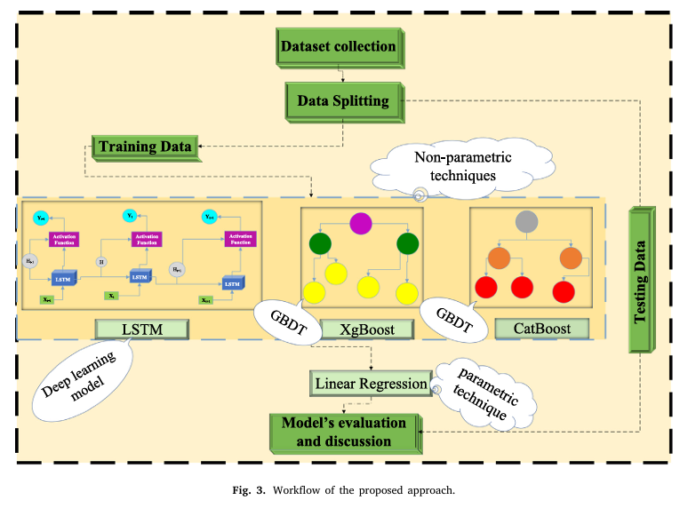
DeepBoost Approach Overview

Slide 14
Component Models

Slide 15
1.Long Short-Term Memory Network (LSTM)
Long Short-Term Memory Network (LSTM) is included to capture temporal dependencies in the EV charging load data, leveraging its ability to model sequential patterns and long-range dependencies.
•Handles long-term dependencies.
•Uses forget, input, and output gates.

Slide 16
2.Extreme Gradient Boosting (XgBoost)
Extreme Gradient Boosting (XgBoost) is employed for its efficiency and accuracy in gradient boosting, enabling the model to capture complex relationships and patterns in the data effectively.
•Efficient, handles missing data.
•Regularized learning to avoid overfitting.

Slide 17
3.Categorical Boosting (CatBoost)
Categorical Boosting (CatBoost) is utilized for its ability to handle categorical features directly and its robust performance with default parameters, simplifying model development and deployment.
•Handles categorical features.
•Fast and scalable gradient boosting.

Slide 18
4.Linear Regression (LR)
4.Linear Regression (LR) serves as a base model for capturing linear relationships and providing a stable baseline, contributing to the overall stability and accuracy of the DeepBoost approach.
•Combines Layer-1 predictions.
•Trains on outputs from LSTM, CatBoost, XgBoost.

Slide 19
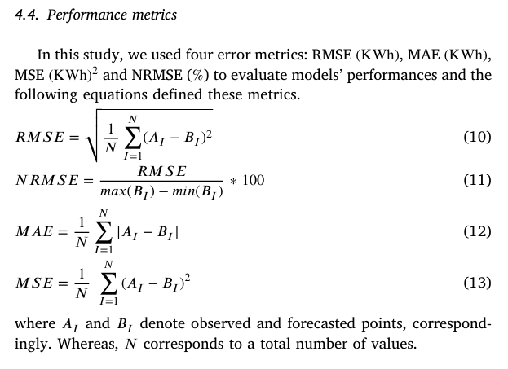
Metrics Used

Slide 20
Performance Comparison
1.The DeepBoost approach is rigorously compared against conventional models such as CatBoost, XgBoost, and LSTM to evaluate its performance improvement and effectiveness comprehensively.
2.Comparison includes Informers, a state-of-the-art time-series forecasting model, to benchmark DeepBoost against advanced deep learning techniques for time-series forecasting.
3.Hybrid deep learning methodologies are also used for comparison, ensuring a thorough assessment of DeepBoost's performance relative to other integrated forecasting methods currently available.
4.Performance metrics such as Mean Absolute Error (MAE), Root Mean Squared Error (RMSE), and Mean Absolute Percentage Error (MAPE) are used to quantitatively evaluate the forecasting accuracy of each method.

Slide 21
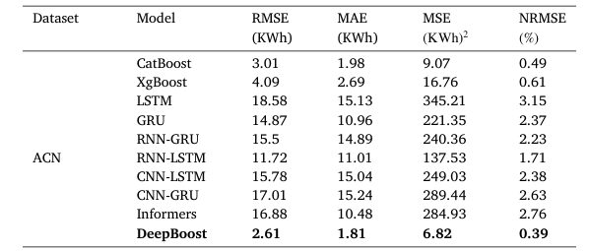
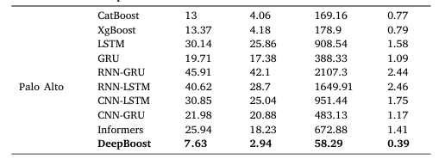
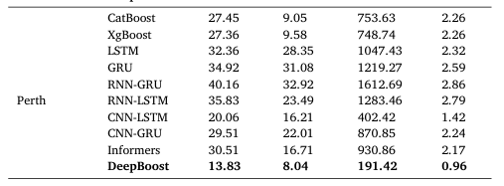
Performance Comparison

Slide 22
Results and Analysis
1.The results demonstrate that DeepBoost outperforms conventional CatBoost, XgBoost, and LSTM models, achieving higher accuracy and lower error rates in day-ahead EV charging load forecasting.
2.DeepBoost exhibits superior performance compared to Informers and other hybrid deep learning methodologies, showcasing its effectiveness as a competitive forecasting technique overall.
3.Analysis reveals that DeepBoost leverages the strengths of its component models, capturing both linear and non-linear patterns in the EV charging load data effectively and adaptively.
4.The improved forecasting accuracy of DeepBoost has practical implications for grid management, enabling better resource allocation and more efficient operation of EV charging infrastructure.

Slide 23
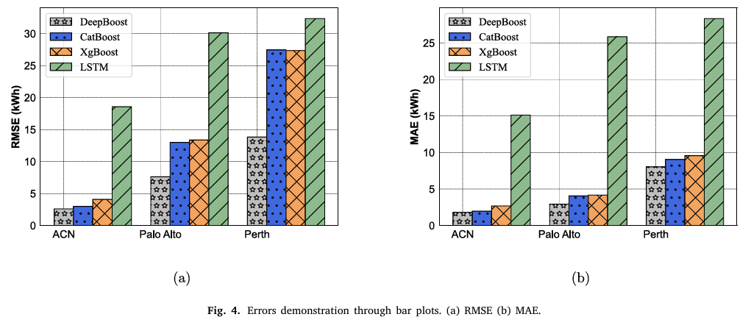
Results and Analysis
1.The results demonstrate that DeepBoost outperforms conventional CatBoost, XgBoost, and LSTM models, achieving higher accuracy and lower error rates in day-ahead EV charging load forecasting.
2.DeepBoost exhibits superior performance compared to Informers and other hybrid deep learning methodologies, showcasing its effectiveness as a competitive forecasting technique overall.

Slide 24
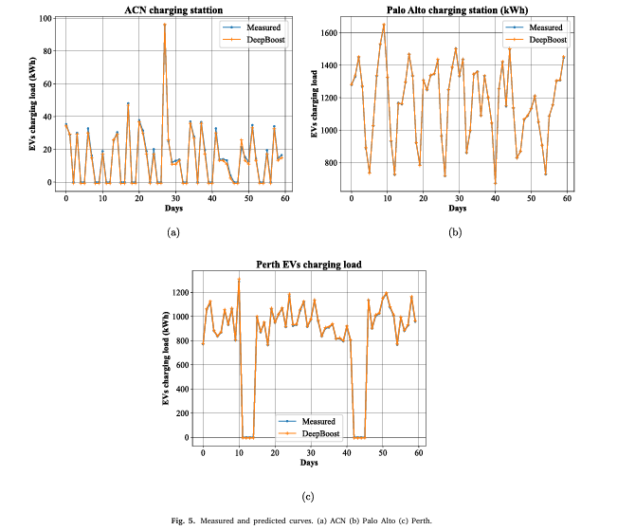
Results and Analysis
# Analysis reveals that DeepBoost leverages the strengths of its component models, capturing both linear and non-linear patterns in the EV charging load data effectively and adaptively.
# The improved forecasting accuracy of DeepBoost has practical implications for grid management, enabling better resource allocation and more efficient operation of EV charging infrastructure.

Slide 25
Conclusion & Future Work
1.The DeepBoost approach offers a robust and accurate solution for forecasting day-ahead EV charging station load, addressing the increasing demand and grid impact from electric vehicles.
2.By integrating CatBoost, XgBoost, LSTM, and LR models, DeepBoost leverages their individual strengths to achieve superior forecasting performance compared to conventional methods.
3.Future work includes exploring the integration of additional data sources, such as real-time grid conditions and user behavior patterns, to further enhance forecasting accuracy dynamically.
4.Further research will focus on optimizing the DeepBoost architecture and exploring adaptive learning techniques to improve its adaptability to changing EV charging patterns in real-world scenarios.

Slide 26
Thank You
If you have any question you can ask

